Slide 1
ME759 High Performance Computing for Applications in Engineering [Spring 2020]
Lecture 23
03/23/2020
Dan Negrut, 2020 ME759 UW-Madison

Slide 2
The quote the day
“The best way to predict the future is to create it.”
-- Peter Drucker, Austrian-born American management consultant. Recipient of the Presidential Medal of Freedom [1909, Vienna – 2005, California]

Slide 3
Things to do
Dan: start the Canvas recording
Everybody else:
Please mute your microphone
Please ask questions (limit: two per person per lecture; after that, pose on Piazza)

Slide 4
joke of the day – worked on it for 40 mins or so
ME759 wasn’t good enough for prime-time television so as of today they downgraded me to radio only. How about my good looks? Don’t they count for anything anymore???

Slide 5
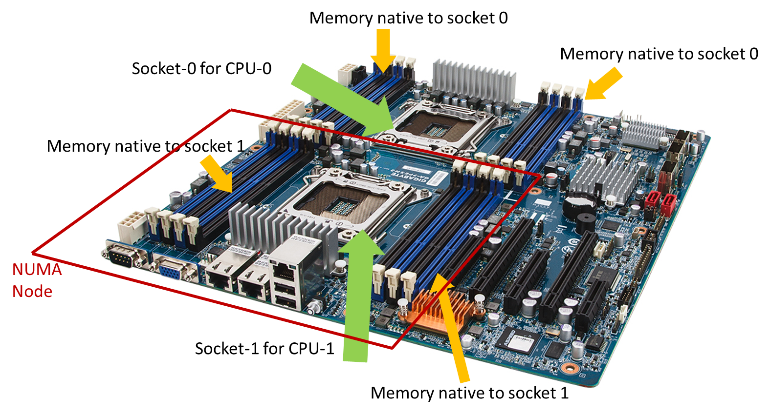
Before we get going…
Last time:
NUMA in the context of OpenMP
Today:
NUMA aspects, wrap up
Cache issues
Optimization aspects (?)
Other tidbits:
Lectures held in Canvas Blackboard Ultra
Recording of the lecture available in Canvas
ME759 Exam: April 15, at 7:15 PM, in Canvas
Review: Tu, April 14, at 7:00 PM, in Canvas
Office hours moved to Canvas (same time/date)
Assignment due on Th, 9 PM
Final Project Proposal due on Friday, 9 PM

Slide 6
NUMA Performance Hit, order of magnitude
What sort of slowdown should one expect if accessing memory outside a NUMA node?
Approximate values:
20% slowdown for reads
30% slowdown for writes
Values above depend on the number of hops required to reach memory bank
Closer NUMA nodes lead to lower values
[ Ulrich Drepper: What Every Programmer Should Know About Memory ]→

Slide 7
NUMA aspects: How the OS comes into play
NUMA aspects where Operating System (OS) comes into play
When a thread mallocs memory, how should this memory be allocated?
Examples:
All memory allocated in one NUMA node
Memory split in chunks, each NUMA node being associated with one such chunk (“striping the memory”)
See next slide for implications
2) The process of having a thread assigned to execute on a certain core
Example: A thread w/ thread id 3 used to execute on Core #X, but then it runs on Core #Y, on a different NUMA node
Related concept: affinity – how you can prod the runtime/OS to assign a thread to a certain core

Slide 8
1) The malloc issue, and the “first touch” story
int main() {
const int N = 4000000;
double *x = (double*)malloc(N * sizeof(double));
double *a = (double*)malloc(N * sizeof(double));
for (i = 0; i < N; i++)
x[i] = simpleFunc(i);
omp_set_num_threads(64);
#pragma omp parallel for schedule(static,5)
for (i = 0; i < N; i++)
a[i] = someFunc(x[i]);
return 0;
}
Memory allocated with malloc not actually set aside when malloc gets hit
That only happens when data is written to it
x first touch is only by Master thread
Memory might be allocated in its NUMA node
a touched by all threads at the same time
Reflect on how chunks of the array are going to be spread all over the memory, very likely in different banks
Reflect on differences between Case 1 & 2
Case 1
int main() {
const int N = 4000000;
double *x = (double*)malloc(N * sizeof(double));
double *a = (double*)malloc(N * sizeof(double));
for (i = 0; i < N; i++)
x[i] = simpleFunc(i);
omp_set_num_threads(64);
#pragma omp parallel for schedule(dynamic,1)
for (i = 0; i < N; i++)
a[i] = someFunc(x[i]);
return 0;
}
Case 2

Slide 9
2) Affinity: Preamble/Backdrop
Imagine the following OpenMP scenario, when having 16 threads, dual socket, 8 cores/socket
The execution hits omp parallel for, with static schedule
Assume Master gets Core 0, Thread 1 gets Core 1, …, Thread 15 gets Core 15
Note: Worker threads folded back at end of parallel for
Next, after worker threads folded back, Master thread goes through a sequential segment of the code
Meanwhile, Core 2 has data in its cache that just sits there
Next yet, the execution hits a second omp parallel for, which this time has a schedule “dynamic”
A thread will be associated with Core 2 and it gets assigned to work on data that is in Core 13’s NUMA node
Can be worse: thread on Core 2 touches data that Core 13 keeps touching too – caches are not happy either

Slide 10
Affinity
Affinity: how threads executing your code get assigned/pinned to CPU cores
These cores can be physical or virtual
Why “virtual cores”?
Recall that one physical core shows up as two or sometimes four virtual cores
Example: Intel’s HTT. IBM has one physical core associated w/ 4 virtual cores
From back in the day: “virtual core” is what enables what we called TLP (thread-level parallelism)

Slide 11
Affinity
Aspects that you might be curious about and/or may want to control
Where is my master thread running ?
Can I control how my threads are assigned in the first place?
Can I pin my threads to prevent migration?

Slide 12
Controlling affinity in OpenMP
Two actors come into play:
OMP_PROC_BIND – allows you to dictate a distribution policy
OMP_PLACES – allows you to control locations

Slide 13
The distribution policy as dictated by OMP_PROC_BIND
export OMP_PROC_BIND = master|close|spread|false|true
master: collocate threads with the master thread
close: place threads close to the master in the places list
spread (default): spread out threads as much as possible
false: set no binding
true: lock threads to a core
NOTE: above, we used an environment variable. Can accomplish via runtime function calls

Slide 14
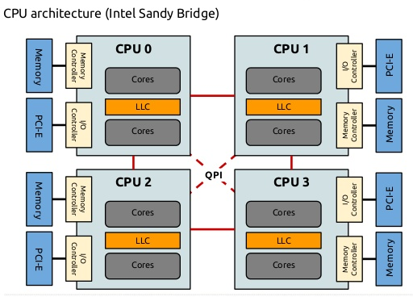
How things come into play
spread (spreads out threads as much as possible)
This is useful if your code is memory bound
Likely to improve aggregate system memory bandwidth
You see more cache (less cache contention)
Example: two sockets, 8 cores per socket, you ask for 8 OpenMP threads
Have first four OpenMP threads on one socket and use its bandwidth for talking w/ main memory
Have last four OpenMP threads on the other socket and use its bandwidth for talking w/ main memory

Slide 15
How things come into play
close (places the threads close to the master)
This is useful if you don’t do many trips to main memory since you keep hitting the cache
Typically useful if you are compute bound
Likely to reduce synchronization costs (single, barrier, etc.)

Slide 16
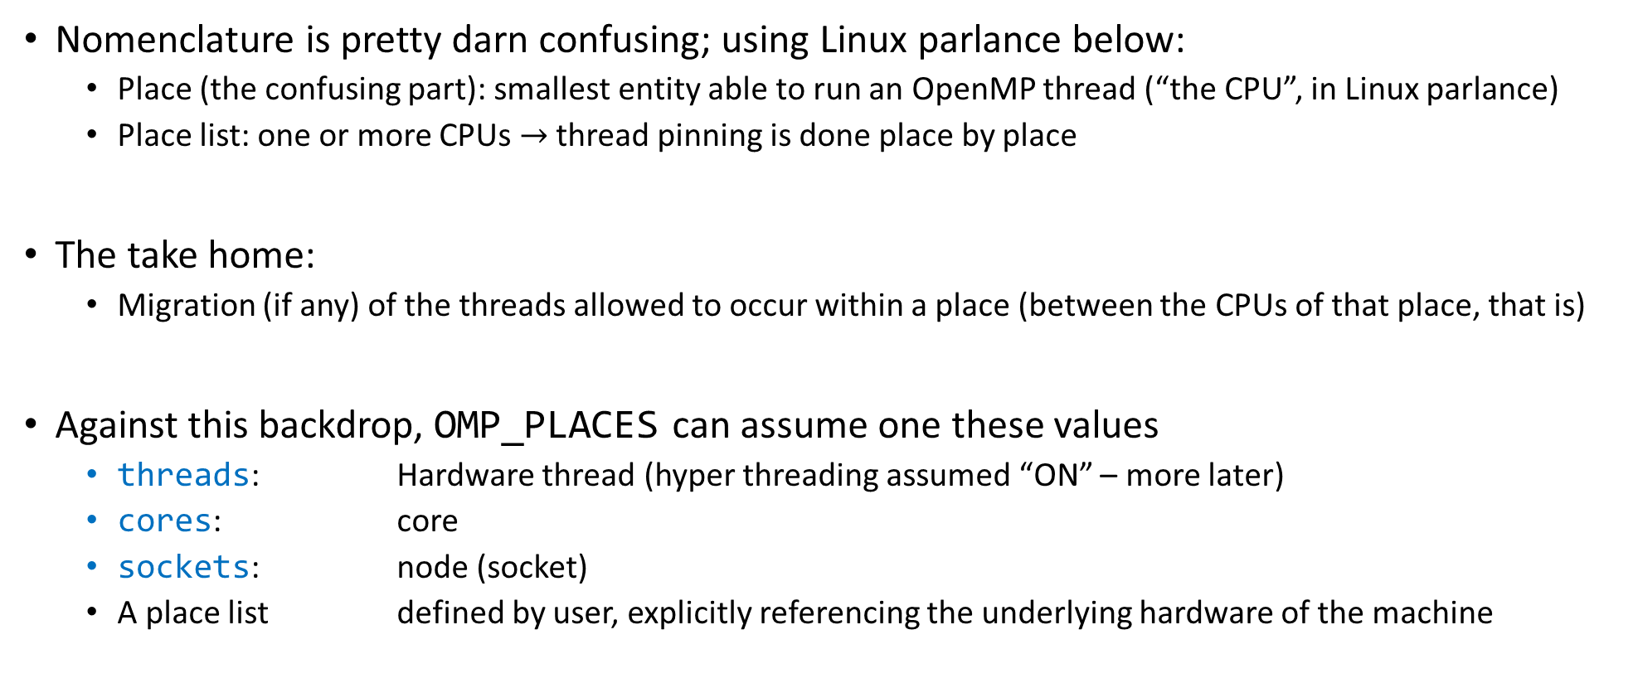
Control locations through OMP_PLACES
Nomenclature is pretty darn confusing; using Linux parlance below:
Place (the confusing part): smallest entity able to run an OpenMP thread (“the CPU”, in Linux parlance)
Place list: one or more CPUs $→$ thread pinning is done place by place
The take home:
Migration (if any) of the threads allowed to occur within a place (between the CPUs of that place, that is)
Against this backdrop, OMP_PLACES can assume one these values
threads: Hardware thread (hyper threading assumed “ON” – more later)
cores: core
sockets: node (socket)
A place list defined by user, explicitly referencing the underlying hardware of the machine

Slide 17
Control locations through OMP_PLACES
(Linux nomenclature, confusing…)
threads, cores, sockets: are OpenMP abstractions, there is some liberty in how the runtime interprets them
Example: is hyper-threading on or off? Because it leads to different outcomes…
A place list is the real thing – you explicitly state the places
The numactl command shows how your hardware in organized
ME759node ~> numactl –H
available: 2 nodes (0-1)
node 0 cpus: 0 1 2 3 4 5 6 7 16 17 18 19 20 21 22 23
node 0 size: 64064 MB
node 0 free: 53060 MB
node 1 cpus: 8 9 10 11 12 13 14 15 24 25 26 27 28 29 30 31
node 1 size: 64482 MB
node 1 free: 59450 MB
node distances:
node 0 1
0: 10 21
1: 21 10
These are half of the available places for this chip

Slide 18
Side trip: the lscpu command [interesting “affinity” information highlighted in bold red]
ME759node ~> lscpu
Architecture: x86_64
CPU op-mode(s): 32-bit, 64-bit
Byte Order: Little Endian
CPU(s): 32
On-line CPU(s) list: 0-31
Thread(s) per core: 2
Core(s) per socket: 8
Socket(s): 2
NUMA node(s): 2
Vendor ID: GenuineIntel
CPU family: 6
Model: 63
Model name: Intel(R) Xeon(R) CPU E5-2640 v3 @ 2.60GHz
Stepping: 2
CPU MHz: 3116.890
CPU max MHz: 3400.0000
CPU min MHz: 1200.0000
BogoMIPS: 5187.98
Virtualization: VT-x
L1d cache: 32K
L1i cache: 32K
L2 cache: 256K
L3 cache: 20480K
NUMA node0 CPU(s): 0-7,16-23
NUMA node1 CPU(s): 8-15,24-31
(output of lscpu continued
in the block to the right)
Notes:
BogoMips (from "bogus" and MIPS) is a crude measurement of CPU speed made by the Linux kernel when it boots to calibrate an internal busy-loop. An often-quoted definition of the term is "the number of million times per second a processor can do absolutely nothing"

Slide 19
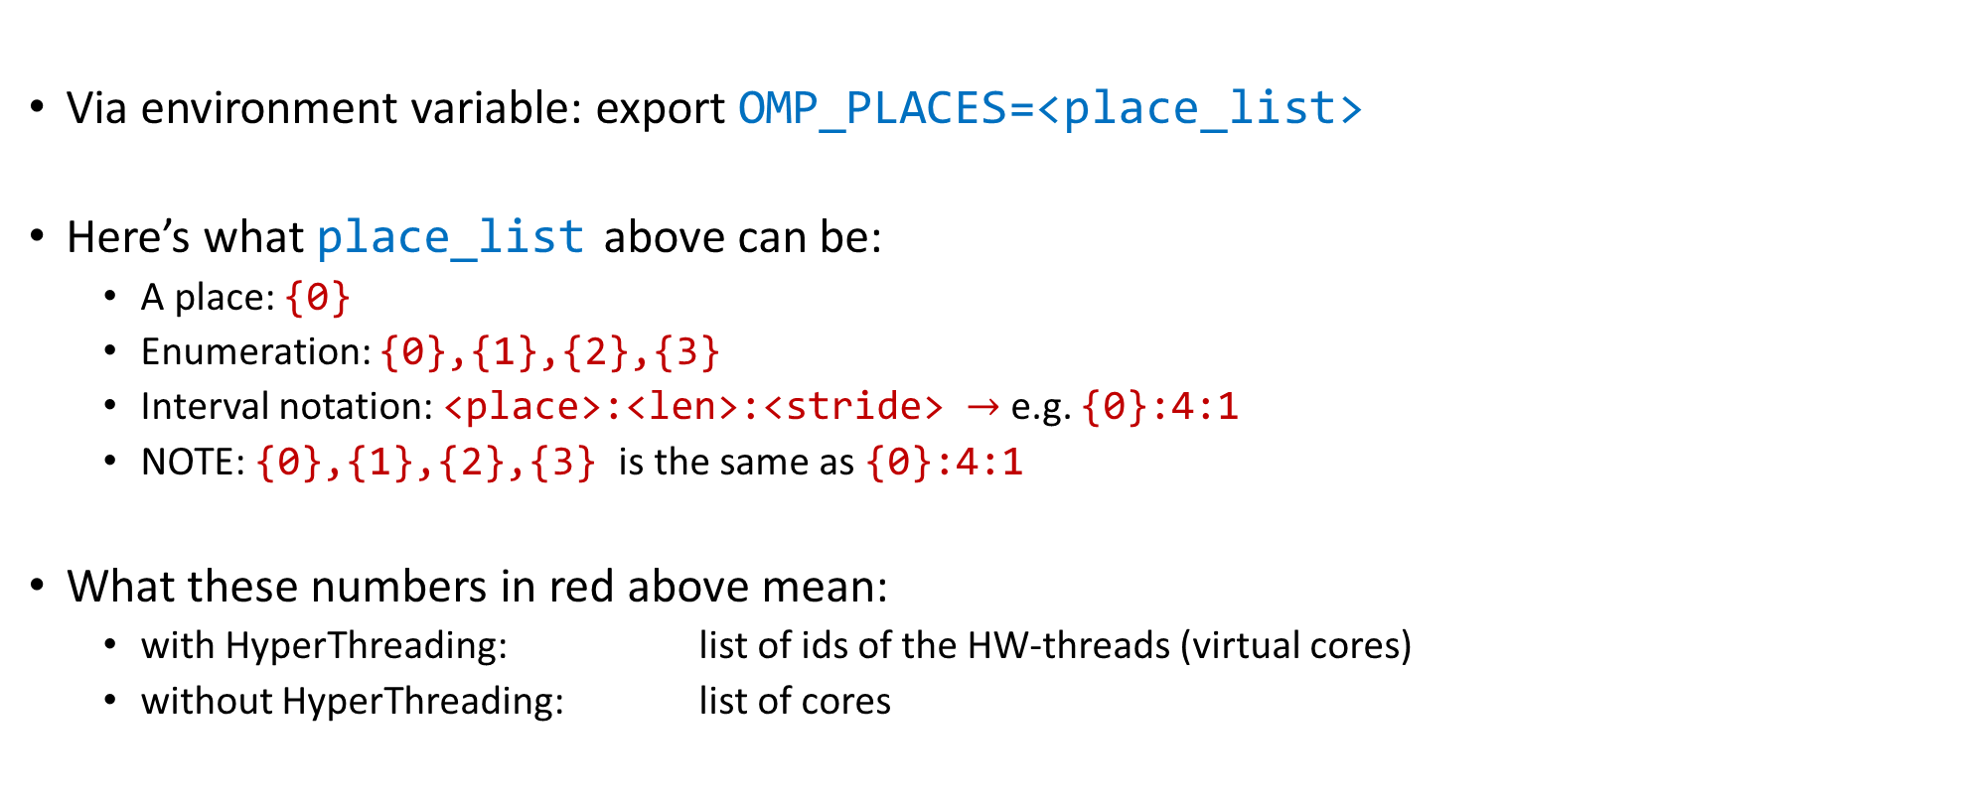
OMP_PLACES: stating the places explicitly
Via environment variable: export OMP_PLACES=<place_list>
Here’s what place_list above can be:
A place: {0}
Enumeration: {0},{1},{2},{3}
Interval notation: <place>:<len>:<stride> $→$ e.g. {0}:4:1
NOTE: {0},{1},{2},{3} is the same as {0}:4:1
What these numbers in red above mean:
with HyperThreading: list of ids of the HW-threads (virtual cores)
without HyperThreading: list of cores
List of [Linux] CPU ids
[Kent Milfeld, Lars Koesterke]$→$

Slide 20











Example [Assume 2 sockets & 4 cores per socket & no hyper-threading enabled]
core
export OMP_NUM_THREADS = 4
export OMP_PROC_BIND = close
export OMP_NUM_THREADS = 4
export OMP_PROC_BIND = spread
←bash shell
#pragma omp parallel private(tid)
{
tid = omp_get_thread_num();
// code here...
}
#pragma omp parallel private(tid)
{
tid = omp_get_thread_num();
// code here...
}
←C code
0 | 1 | 2 | 3
0 |  | 1
2 |  | 3
←thread id (tid)
←cpu id
0 1
2 3
4
5 6
7
0 1
2 3
4
5 6
7
COMPACT PACKING
SCATTER PACKING
[Kent Milfeld, Lars Koesterke]$→$

Slide 21
Example [Assume 2 sockets & 4 cores per socket & no hyper-threading enabled]
core
export OMP_NUM_THREADS = 4
export OMP_PLACES =‘{0},{1},{2},{3}’
export OMP_NUM_THREADS = 4
export OMP_PLACES = ‘{0},{2},{4},{6}’
#pragma omp parallel private(tid)
{
tid = omp_get_thread_num();
// code here...
}
#pragma omp parallel private(tid)
{
tid = omp_get_thread_num();
// code here...
}
0 | 1 | 2 | 3
0 |  | 1
2 |  | 3
←thread id (tid)
←cpu id
0 1
2 3
4
5 6
7
0 1
2 3
4
5 6
7
COMPACT PACKING
SCATTER PACKING
[Kent Milfeld, Lars Koesterke]$→$

Slide 22
Example [Assume 2 sockets & 4 cores per socket & hyper-threading not enabled]
core
export OMP_NUM_THREADS = 4
export OMP_PLACES =‘{0}:4’
export OMP_NUM_THREADS = 4
export OMP_PLACES = ‘{0}:4:2’
#pragma omp parallel private(tid)
{
tid = omp_get_thread_num();
// code here...
}
#pragma omp parallel private(tid)
{
tid = omp_get_thread_num();
// code here...
}
0 | 1 | 2 | 3
0 |  | 1
2 |  | 3
←thread id (tid)
←cpu id
0 1
2 3
4
5 6
7
0 1
2 3
4
5 6
7
COMPACT PACKING
SCATTER PACKING
[Kent Milfeld, Lars Koesterke]$→$

Slide 23








Example [Assume 2 sockets & 4 cores per socket & hyper-threading enabled]
core
export OMP_NUM_THREADS = 8
export OMP_PLACES = threads
export OMP_NUM_THREADS = 8
export OMP_PLACES = cores
←bash shell
#pragma omp parallel private(tid)
{
tid = omp_get_thread_num();
// code here...
}
#pragma omp parallel private(tid)
{
tid = omp_get_thread_num();
// code here...
}
←C code
0 | 1 | 2 | 3
4 | 5 | 6 | 7
0 | 1 | 2 | 3
4 | 5 | 6 | 7
←thread id (tid)
←cpu id
0, 8 1, 9 2, 10 3, 11
4, 12 5, 13 6, 14 7, 15
0, 8 1, 9 2, 10 3, 11
4, 12 5, 13 6, 14 7, 15
HW-thread
Binding to Single HW-thread
Binding to core
[Kent Milfeld, Lars Koesterke]$→$

Slide 24


Example [Assume 2 sockets & 4 cores per socket & hyper-threading enabled]
core
export OMP_NUM_THREADS = 8
export OMP_PLACES = ‘{0}:8’ (#1)
export OMP_PLACES = ‘{8}:8’ (#2)
export OMP_NUM_THREADS = 8
export OMP_PLACES = cores
←bash shell
#pragma omp parallel private(tid)
{
tid = omp_get_thread_num();
// code here...
}
#pragma omp parallel private(tid)
{
tid = omp_get_thread_num();
// code here...
}
←C code
0 | 1 | 2 | 3
4 | 5 | 6 | 7
(#1)
0 | 1 | 2 | 3
4 | 5 | 6 | 7
←thread id (tid)
←cpu id
0, 8 1, 9 2, 10 3, 11
4, 12 5, 13 6, 14 7, 15
0, 8 1, 9 2, 10 3, 11
4, 12 5, 13 6, 14 7, 15
0 | 1 | 2 | 3
4 | 5 | 6 | 7
(#2)
HW-thread
0, 8 1, 9 2, 10 3, 11
4, 12 5, 13 6, 14 7, 15
Binding to Single HW-thread
Binding to core
[Kent Milfeld, Lars Koesterke]$→$

Slide 25
Example [Assume 2 sockets & 4 cores per socket & hyper-threading enabled]
core
export OMP_NUM_THREADS = 4
export OMP_PLACES = threads
export OMP_PROC_BIND = close
export OMP_NUM_THREADS = 4
export OMP_PLACES = cores
export OMP_PROC_BIND = spread
←bash shell
#pragma omp parallel private(tid)
{
tid = omp_get_thread_num();
// code here...
}
#pragma omp parallel private(tid)
{
tid = omp_get_thread_num();
// code here...
}
←C code
0 | 1 | 2 | 3
0 |  | 1
2 |  | 3
←thread id (tid)
←cpu id
0, 8 1, 9 2, 10 3, 11
4, 12 5, 13 6, 14 7, 15
0, 8 1, 9 2, 10 3, 11
4, 12 5, 13 6, 14 7, 15
HW-thread
Binding to Single HW-thread
Binding to core
[Kent Milfeld, Lars Koesterke]$→$

Slide 26
Affinity & cc-NUMA
There are two reasons why affinity is good
First: we avoid remote data NUMA-node access; i.e., costly local network hops
Second: overhead of cache-coherence mechanism starts kicking in
Lack of affinity in multi-threaded execution (OpenMP):
A small amount of data out of a big chunk of data that is physically next to CPU0 can get stored in cache of CPU3 as well
Changes made by CPU3 are going to invalidate cache of CPU0; not good
cc-NUMA: cache-coherent NUMA
The run time must maintain coherence between caches in different NUMA nodes
Topic of next section

Slide 27
Loose ends: topics discussed
Non-uniform memory access (NUMA)
Cache issues

Slide 28
The Memory Hierarchy
[Bryant and O‘Hallaron:
Computer Systems - A Programmer's Perspective 3rd edition] →
L0:
Regs
CPU registers hold words retrieved from the L1 cache.
Smaller,
faster,
and
costlier
(per byte)
storage
devices
L1:
L1 cache
(SRAM)
L1 cache holds cache lines retrieved from the L2 cache.
L2:
L2 cache
(SRAM)
L2 cache holds cache lines
retrieved from L3 cache
L3:
L3 cache
(SRAM)
L3 cache holds cache lines
retrieved from main memory.
Larger,
slower,
and
cheaper
(per byte)
storage
devices
L4:
Main memory
(DRAM)
Main memory holds disk blocks retrieved from local disks.
L5:
Local secondary storage
(local disks)
Local disks hold files retrieved from disks
on remote servers
L6:
Remote secondary storage
(e.g., web servers, file servers)

Slide 29
Cache Memories [old slide]
Cache memories: small, fast SRAM-based memories managed transparently
Purpose: Hold frequently accessed blocks of main memory
When very useful: when execution displays locality (spatial/temporal)
Typical system structure:
CPU chip
Register file
ALU
Cache
memory
System bus
Memory bus
Main
memory
Bus interface
I/O
bridge
[Bryant and O‘Hallaron: CMU] →

Slide 30
How Cache Comes into Play [old slide, with a facelift]
Typically*, the read/write operations go through cache
Caches used to hold both data and instructions
L1: tens of KB (per core)
L2: hundreds of KB (per core)
L3: tens of MB (per CPU)
(Intel(R) Xeon(R) CPU E5-2640 v3 @ 2.60GHz - from ten slides ago or so…)
CPU MHz: 3116.890
CPU max MHz: 3400.0000
CPU min MHz: 1200.0000
BogoMIPS: 5187.98
Virtualization: VT-x
L1d cache: 32K
L1i cache: 32K
L2 cache: 256K
L3 cache: 20480K
NUMA node0 CPU(s): 0-7,16-23
NUMA node1 CPU(s): 8-15,24-31
CPU Core
L1 D$
L1 I$
L2 Cache
L3 Cache
Bus
Main Memory

Slide 31
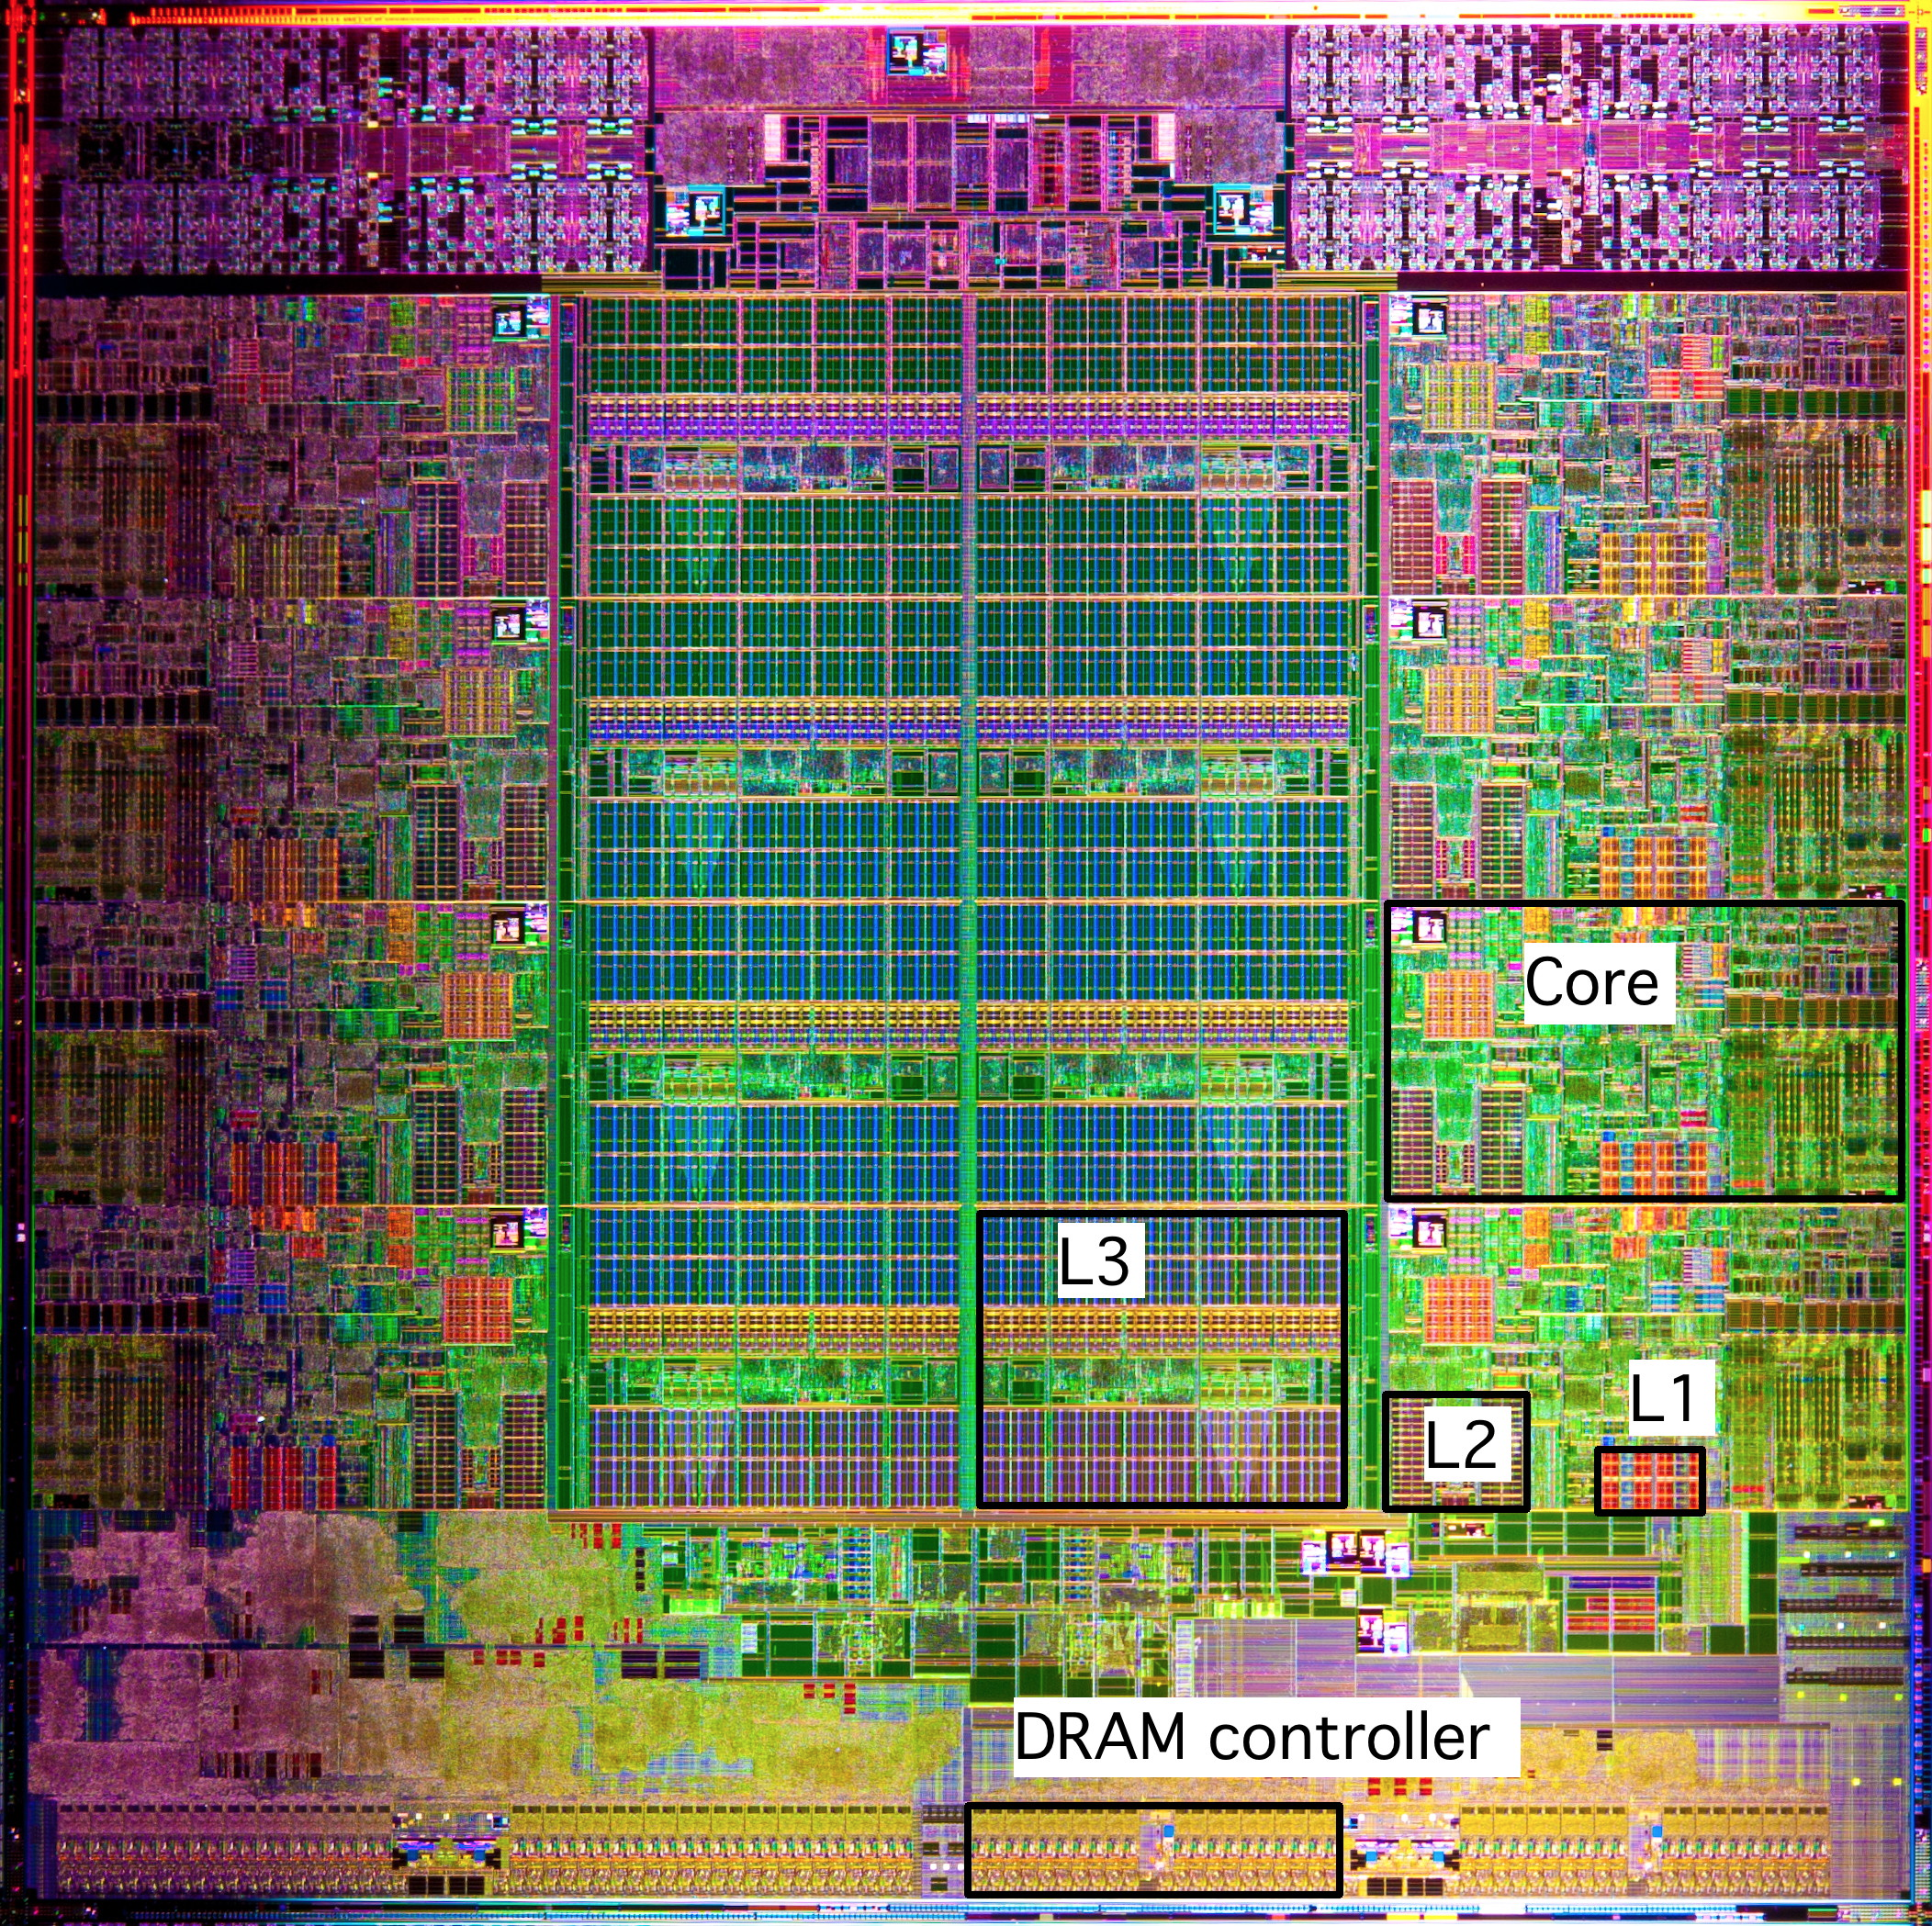
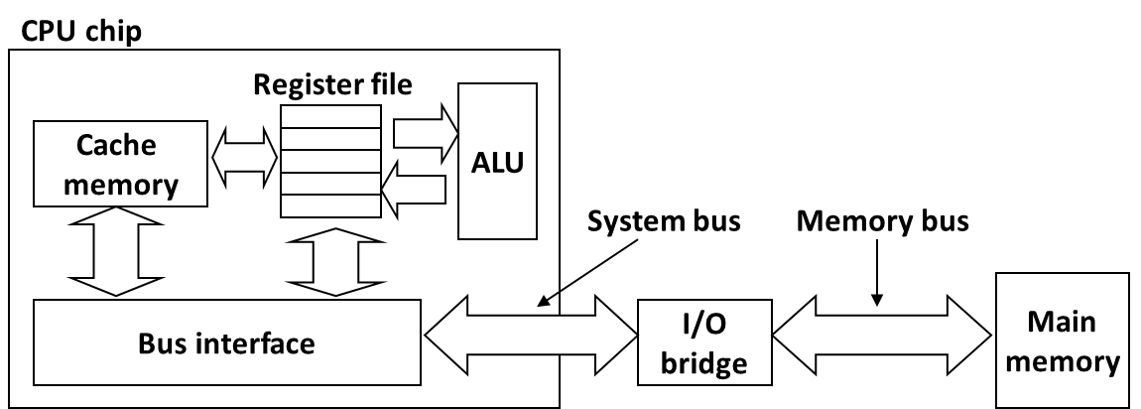
What it Really Looks Like
Intel Sandy Bridge
Processor Die
L1: 32KB Instruction + 32KB Data
L2: 256KB
L3: 3–50MB
[Bryant and O‘Hallaron: CMU] →

Slide 32
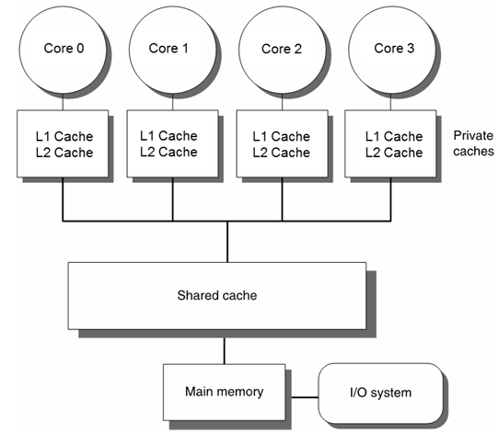
What We Are Interested in: Caches in a Multi-Core Setup
We almost exclusively discussed caches in conjunction with one core
What if there is another core, and this other core changes the memory in a block that you just cached?

Slide 33
Multi-Core Architecture: Two Memory Aspects Coming Into Play
Memory consistency model
Memory coherence
Computer Science at UW-Madison: active in this area
Mark Hill, (Emeritus) David Wood, Karu Sankaralingam, Matt Sinclair
Book on this very topic
PhDs granted on consistency models and/or coherence mechanisms
Topic is deep

Slide 34
The concept of “memory consistency” [OLD SLIDE]
__device__ volatile int X = 1, Y = 2;
__device__ void writeXY()
{
X = 10;
Y = 20;
}
__device__ void readXY()
{
int A = Y;
int B = X;
}
Backdrop
Thread_1 executes writeXY()
Thread_2 executes readXY()
Question: what values can A and B assume?
For sequential consistency (“strongly-ordered mem. model”), the only possible scenarios are
A=2 and B=1
A=2 and B=10
A=20 and B=10
For weak consistency (“weakly-ordered memory model”), it is possible to have this
A=20 and B=1

Slide 35
Consistency vs. Coherence
Consistency establishes a set of rules that governs the collective actions of the threads relative to the entire system memory
Coherence regards expected behavior that *one* memory location must display relative to transactions carried out by multiple threads running on multiple cores

Slide 36
Consistency vs. Coherence
Earning the attribute of “consistent memory” (for instance “sequential consistency”) imposes a set of stronger/stricter requirements that need to be met compared to what it takes to earn the “coherent memory” attribute
Coherence: with some hand waving, it captures the expectation that if a thread running on core A changes a value in a memory location, other thread running on core B will read the updated value even though the read might occur relatively soon after the change of the value takes place per A’s action
“relatively soon”: a bit of a mystery to me

Slide 37
Consistency vs. Coherence
Cache coherence is a mechanism, a hardware protocol to ensure that memory updates propagate to other cores. Cores will then be able to agree on the values of information stored in memory, as if there were no cache at all
Cache consistency defines a programming model: when do memory writes become visible to other cores?
Defines the ordering of memory updates
A contract between the hardware and the programmer: if we follow the rules, the results of memory operations are guaranteed to be predictable
[Scott B. Baden ]$→$

Slide 38
Caches and Coherency, bottom line
Speeding up sequential computing accomplished through use of large caches
Note that each OpenMP thread actually does engage in sequential computing
Caching consequence: multiple copies of a physical memory location may exist at different hardware locations
For program correctness, caches must be kept coherent

Slide 39
Caches Coherence Mechanisms
Significant overhead associated with implementing cache coherence
One of the main reasons why OpenMP doesn’t scale
Another reason: memory speed is low, bandwidth saturates way before cores saturate
Two established approaches for enforcing cache coherence
Directory-based
Snooping-based

Slide 40
Cache Coherence Mechanisms: Directory-Based [1/2]
Encountered in systems with large core counts
Example: Intel Xeon Phi 7290 [72 core count, chip now discontinued]
Builds on the assumption that there is a fast point-to-point connection between the cores
Requires a directory indicating which data is stored by which core’s cache
Pros: scales better than the snooping-based alternative
Cons: complex, overhead somewhat high

Slide 41
Cache Coherence Mechanisms: Directory-Based [2/2]
Directory typically split into pieces; each piece stored by one core
Each mem. transaction needs to consider the possibility of invalidating a cache line in some other core’s cache
Overhead grows, particularly if you have NUMA architectures
Ultimately, it’s not OpenMP’s fault – it’s an interplay between the underlying hardware and the shared memory model embraced
Threads are heavy
Memory transactions incur overhead

Slide 42
Cache Coherence Mechanisms: Snooping/Sniffing-Based
Encountered in systems with small core counts
Builds on the assumption of a front-side bus; i.e., all memory transactions initiated by any core are processed through one connection/junction to the system memory
Pros: simple
Cons: doesn’t scale
Snooping happens here

Slide 43

MESI Protocol: Example of Snooping-Based Cache Coherence Protocol

Slide 44
MESI: Invalidation-Based Coherence Protocol
Cache lines have state bits
Data migrates between processor caches, state transitions maintain coherence
MESI Protocol has four states: M: Modified, E: Exclusive, S: Shared, I: Invalid
Processor A’s Cache
Processor B’s Cache
zz
1. Read variable “zz”
I→E
“exclusive”
zz
zz
E→S
I→S
2. Read variable “zz”
“shared”
“shared”
zz
3. Write variable “zz”
S→M
S→I
Cache line
is invalidated
“modified”
“invalid”
[J. Marathe]→

Slide 45
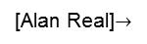
Coherency – Simplified Further [cooked up example]
Further simplify MESI for sake of simple discussion on next slide
Assume now that each cache line can exist in one of 3 states:
Exclusive: the only valid copy in any cache
Read-only: a valid copy but other caches may contain it
Invalid: out of date and cannot be used
In this simplified coherency model
A READ on an invalid or absent cache line will be cached as read-only or exclusive
A WRITE on a line not in an exclusive state will cause all other copies to be marked invalid and the written line to be marked exclusive
[Alan Real]$→$

Slide 46
Cache coherency cartoon
Exclusive
Read-Only
Invalid
W
P
R
P
W
P
P
R
L1C
L1C
L1C
L1C
L2C
L2C
L2C
L2C
Interconnect
Memory
[Alan Real]→

Slide 47
How is this relevant for OpenMP? The “False Sharing” Pitfall
Recall cache lines typically are 64 byte long
Can store, for instance, 8 double precision values or 16 integers
False sharing: happens when two threads are both writing into different locations within the same cache line
Each write will invalidate the cache line
Memory transactions galore
Example when this happens
omp parallel for construct with unfortunate scheduling (static w/ stride 1, or dynamic w/ stride 1)

Slide 48
False Sharing: Insidious
Recall that for caches to work, the code should actively embrace the idea of locality in execution
Spatial locality
Temporal locality
However, you don’t want two different threads to hit memory that is too close to each other
If operating too close, two threads can lead to false sharing
Spatial locality can slow down the execution

Slide 49
False Sharing: symptoms
Poor performance
High, non-deterministic numbers of cache misses (particularly if NUMA comes into play)
Mild, non-deterministic, unexpected load imbalance

Slide 50
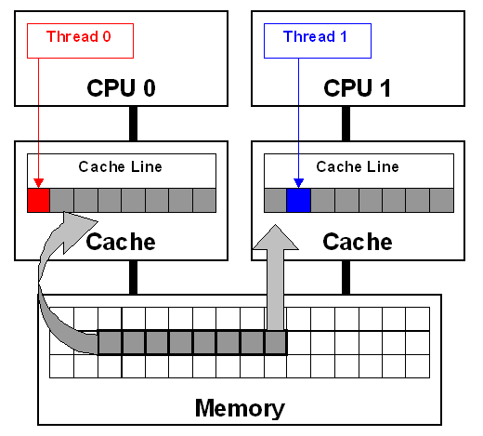
False Sharing Example [1/2]
double sum_local[8];
double sum = 0.0;
#pragma omp parallel num_threads(8)
{
int me = omp_get_thread_num();
sum_local[me] = 0.0;
#pragma omp for
for (i = 0; i < N; i++)
sum_local[me] += x[i] * y[i];
#pragma omp atomic
sum += sum_local[me];
}
How can this instance of false sharing be fixed?
[IOMPP]→

Slide 51
False Sharing Example [2/2]
Easy fix: use reduction(+,sum)
Look into other alternatives
Basic idea, use private/local variables
Fall back on “false sharing” only once, at the end

Slide 52
Sometimes This Fixes It
Reduce the frequency of false sharing by using thread-local copies of data
The thread-local copy will be read and modified frequently
When complete, copy the result back to the data structure
struct ThreadParams {
// For the following 4 variables: 4*4 = 16 bytes -> fits in one cache line…
unsigned long thread_id;
unsigned long v; // Frequently accessed variable (for reads/writes)
unsigned long start, end;
};
void threadFunc(void *parameter) {
ThreadParams *p = (ThreadParams *)parameter;
// local copy for read/write access variable
unsigned long local_v = p->v;
for (unsigned long local_dummy = p->start; local_dummy < p->end; local_dummy++) {
// Functional computation, would read/write the “v” member.
// Keep reading/writing local_v instead
}
p->v = local_v; // Update shared data structure only once
}
[IOMPP]→

Slide 53
Another Way to Fix This [Ugly + Architecture Dependent]
When using an array of data structures, pad the structure to the end of a cache line to ensure that the array elements begin on a cache-line boundary
If you cannot ensure that the array is aligned on a cache line boundary, pad the data structure to twice the size of a cache line
struct ThreadParams {
// For the following 4 variables: 4*4 = 16 bytes
unsigned long thread_id;
unsigned long v; // Frequent read/write access variable
unsigned long start, end;
// expand to 64 bytes to avoid false-sharing
// (4 unsigned long variables + 12 padding)*4 = 64
int padding[12];
};
__declspec(align(64)) struct ThreadParams Array[10];
[IOMPP]→

Slide 54
OpenMP: What Speed Ups Should You Expect?
For N cores, to get a speed-up of a factor of N is rare
Problem should be embarrassingly parallel, and you should not max out mem bandwidth (high arithmetic intensity, that is)
Problem should allow for a good partitioning of the data
Your code should have thoughtful affinity (impact of NUMA is controlled)
Many real-life applications require synchronization and/or handle unstructured data
cc-NUMA adds significant overhead
Scaling doesn’t materialize after a certain point
Culprits: combination of hopping via UPI/HT and cache-coherence overhead
Question: Is fewer fat chips better than more slim chips?
fat/slim: higher/lower core count per chip

Slide 55
Opportunities for Efficiency Gains
Use of loop unrolling, right compiler flags, etc.
Speed up factor: 1.5 – 2X
Haven’t covered this too much, briefly covered in 459 class
Inspired use of cache
Speed up factor: 3 – 5X
Use of vectorization (AVX2/AVX512) – use mips in OpenMP parallel for
Speed up factor: 2X
Use of multiple cores
Speed up factor: 5 – 6X
You can hit all these at the same time
Combined speed up factor: 40X

Slide 56
Critical Thinking in Code Design/Development, with an Eye Towards Improving Performance

Slide 57
Motivation, ME759 segment on “critical thinking/code optimization”
Understanding how things work under the hood can translate into improved performance
Segment draws on disparate things we covered thus far

Slide 58
Acknowledgement
Some slides in this segment come from
Material from class 15-213 at CMU
Nathan Bell (while he was at NVIDIA)
Georg Hager, Jan Eitzinger, Gerhard Wellein – material presented at Supercomputing 2019
Matt Godbolt, maker of Compiler Explorer

Slide 59
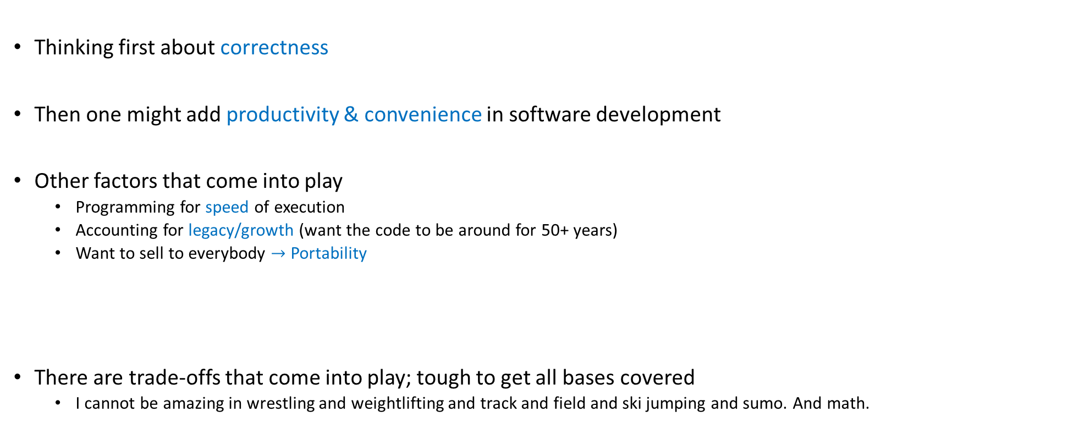
Mindsets, approaching software development
Thinking first about correctness
Then one might add productivity & convenience in software development
Other factors that come into play
Programming for speed of execution
Accounting for legacy/growth (want the code to be around for 50+ years)
Want to sell to everybody $→$ Portability
There are trade-offs that come into play; tough to get all bases covered
I cannot be amazing in wrestling and weightlifting and track and field and ski jumping and sumo. And math.

Slide 60
Angle of attack, this module
Focus: understand how concepts covered thus far can lead to execution speed gains
Particularly relevant for OpenMP code, when your code runs on the CPU
However, some lessons carry over to the GPU as well
End goal: write faster programs, to handle large datasets fast

Slide 61
Angle of attack, this module
Module brings together concepts we’ve covered thus far; i.e., knowledge about:
Compilers, and how they work [covered mostly in ME459, we’ll further elaborate on this]
Memory hierarchy, latencies, bandwidths
Instruction level parallelism (pipelining, branch prediction, etc.)
We’ll use a couple of examples to show how a) through c) above come into play
The hope is that the points made in these example will help you down the road

Slide 62
Assessing performance, common sense things to keep in mind
Second quote of the day: “You can't manage what you can't measure.”
Peter Drucker -- Austrian-born American management consultant, educator
Timers are needed to measure the performance of your code
Issue 1: make sure you understand the level of resolution of your timers
Example: if your code runs in 1 millisecond, your timer’s level of resolution should be at least 1 microsecond
Issue 2: cross platform, high resolution timers are surprisingly hard to come by
Issue 3: steep learning curve to get to point where you get return on investment for timing/profiling

Slide 63
Assessing performance, common sense things to keep in mind
Find out where the bottleneck of the execution is. Time/profile heavily that part
Almost always this is tied to some loop; hopefully you have control over what happens in that loop
Try to understand how execution time is split between “user time” and “system time”
There is nothing that you can do about the speed of printf
There is nothing that you can do if the “user time” for your program is 10%

Slide 64
Assessing performance, common sense things to keep in mind
Measure repeatedly to get statistical data about your program’s execution time
Timers: command-line timers or code-embedded timers
“command-line timers”: you measure the time it takes the OS to load your program from disk into memory, launch it, and then execute it
You care about the execution time only
Bottom line: when given a choice, prefer “code-embedded timers” to “command-line timers”
NOTE: if you measure repeatedly, your code is not going to be brought over from disk
Thus, you’re not going to have a “cold start” if you measure repeatedly

Slide 65
Assessing performance, common sense things to keep in mind
“cold start” also applies to loading data into memory
Example:
Suppose your program uses 40 KB of data
This would fit in L1 cache, on a quiet machine with a decent chip
40KB of data:
It can be buried on the disk since you haven’t used it since last year: cold start
It can be already in L1 since you run your code 1000 times to get statistical info about run times: hot start
Thus, if you measure repeatedly, your data is not going to be brought over from disk
In other words, you’re not going to have a “cold start” if you measure repeatedly

Slide 66
Assessing performance, common sense things to keep in mind
“quiet machine”
Recall difference between “wall-clock time” and “execution time”
Good idea to time on a quiet machine
Alternative 1: You are one of 40 programs running, and you do so at some sad priority level
Alternative 2: Other than the kernel, you are perhaps the only show in town, on that machine

Slide 67
Assessing performance, common sense things to keep in mind
In general, if you are assessing performance for improving speed, carry out timing/profiling exercise on the platform/chip on which you’ll be running the code
Assessing & improving performance for on a Windows machine w/ Microsoft compiler and a fat Intel chip with large caches will produce different results than running gcc-compiled code on Raspberry Pi w/ Linux

Slide 68
Rules of the thumb, squeezing performance out of solution
Think critically about the code you’re writing
Get to know your hardware: core count, how much memory, what latencies, bandwidth, etc.
Write compiler-friendly code [more to come, on this topic]
Watch out for optimization blockers; i.e., procedure calls & memory references
Look carefully at innermost loops (where most work is done)
Choose the right algorithm for your problem

Slide 69
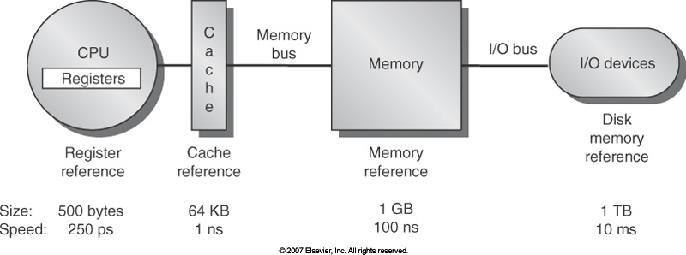
Know your memory latencies [typical embedded, desktop, and server computers]
[Computer Architecture, Hennessey and Patterson, fourth edition]$→$
Notes:
These numbers are by now obsolete, but orders of magnitude still relevant.
What does this imply?
For a frequency of 2GHz, 100ns for a memory access translates into 200 cycles.
But in one single cycle, a multi-core CPU, e.g. AMD Intralagos, can perform 32 fused multiply-add (FMA).
Conclusion: performance is dictated by efficiency of memory transactions <-> number crunching is free.
Goal: try to keep data in cache. You cannot directly control this, but you can arrange your code to provide good temporal and spatial locality.

Slide 70
Know your Bandwidths in your system
Latency:
Low
GPU cores
CPU Core
Cache
NOTE: The width of the black lines is proportional to the bandwidth.
80GB/s
50-100
GB/s
1000
GB/s
Latency:
Medium Low
Latency:
Rel.Low
System Memory
GPU Memory
Infiniband to next Compute Node
6GB/s
8-16 GB/s
Latency:
High
Latency:
Medium

Slide 71
Thinking critically about the expected speedup outcome
Dealing w/ Big Data: You are trying to optimize your code for speed
What makes for a good speed-up? What would make you happy?
1.2X speedup?
1.5X speedup?
2X speedup?
10X speedup?
Answer depends on how polished the code is
Rule of thumb in engineering: if your job finishes overnight, it’s most often ok
“Job”: might be running a long program once, or running a short one a million times
“Job”: something that when completed produces data that yields information that leads to knowledge that produces insights that assist your decision making

Slide 72
High Performance Computing: Questions to Ask
Do I understand the performance behavior of my code?
Does the performance match a model I have made?
What is the optimal performance for my code on a given machine?
High Performance Computing == Computing at the bottleneck
Can I change my code so that the “optimal performance” gets higher?
Circumventing/ameliorating the impact of the bottleneck
My model doesn’t work – what’s wrong?
This is the case in which you are about to learn something
Performance monitoring/microbenchmarking can help sort things out

Slide 73
The roofline model [supplemental material]
I encourage you to look into the “roofline model” to assess code performance
Access here “roofline model” material from Supercomputing 2019

Slide 74
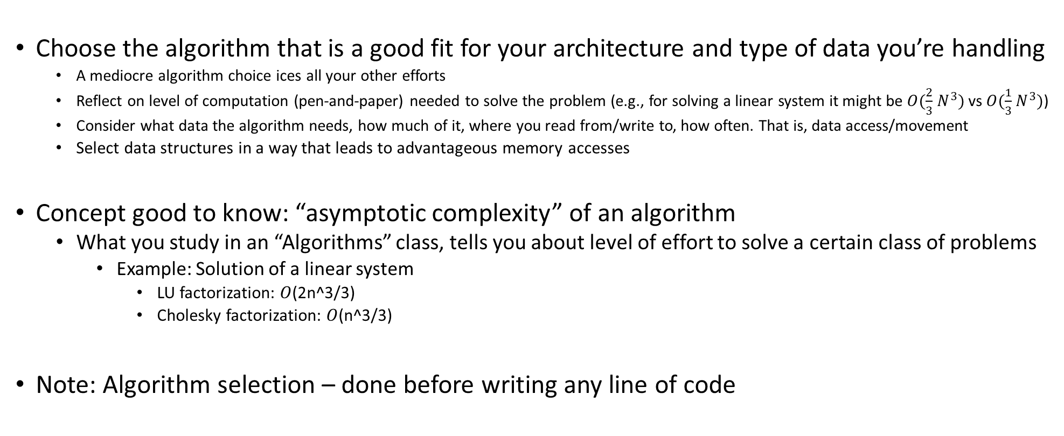
Starting off on the right foot: choose the right algorithm
Choose the algorithm that is a good fit for your architecture and type of data you’re handling
A mediocre algorithm choice ices all your other efforts
Reflect on level of computation (pen-and-paper) needed to solve the problem (e.g., for solving a linear system it might be $O(\frac{2}{3}{ N}^{3})$ vs $O(\frac{1}{3}{ N}^{3})$)
Consider what data the algorithm needs, how much of it, where you read from/write to, how often. That is, data access/movement
Select data structures in a way that leads to advantageous memory accesses
Concept good to know: “asymptotic complexity” of an algorithm
What you study in an “Algorithms” class, tells you about level of effort to solve a certain class of problems
Example: Solution of a linear system
LU factorization: $O$(2n^3/3)
Cholesky factorization: $O$(n^3/3)
Note: Algorithm selection – done before writing any line of code

Slide 75
Starting off on the right foot: choose the right algorithm
When working on problem, there’s more to performance than asymptotic complexity
Why?
Because asymptotic complexity is most often defined by number of operations
Memory transactions are rarely considered – they are specific to the hardware you’ll eventually use to run
Take-home message: there is more to the story than complexity
If you understand how the computer works, it can guide you in designing a good/fast solution
Things to keep in mind:
A problem can be solved by many algorithms (or approaches)
Also, one algorithm can have many implementations
Spend time before you write any line of code!

Slide 76
Asses the “Arithmetic Intensity” associated w/ your problem
Arithmetic intensity: how much math you do per byte of data you bring from memory
You can be in one of three cases:
Case 1: compute bound
That is, high arithmetic intensity – the ALU works a lot, not a whole amount of data movement to/from memory
Case 2: memory bound
You are moving data back and forth, likely only small parts of the data moved gets changed and/or used
Think cache misses
Case 3: “Middle-earth” (J. R. R. Tolkien)
Somewhere in between compute-bound and memory-bound

Slide 77
Arithmetic Intensity: Putting things in perspective
J. R. R. Tolkien’s “Middle-earth”
Memory bound
Compute bound
FLOP/Byte
SAXPY
FFT
SGEMM (matrix-matrix multiplication)

Slide 78
Simple Optimization Technique: Fusing Transformations
One way to move the needle from “memory bound” towards “compute bound”
Basic idea
Do not bring data into cache twice
If you use data X, Y, and Z – bring this data from memory once and then forget about it
Why is it better?
You avoid memory traffic
for (int i = 0; i < N; i++)
U[i] = F(X[i],Y[i],Z[i]);
for (int i = 0; i < N; i++)
{
U[i] = F(X[i],Y[i],Z[i]);
V[i] = G(X[i],Y[i],Z[i]);
}
for (int i = 0; i < N; i++)
V[i] = G(X[i],Y[i],Z[i]);
Loop Fusion
Notes:
So what can we do to maximize the work we do for the same amount of data transferred?
Simple idea… But powerful

Slide 79
Fusing transformations on previous slide
Original implementation
More thoughtful implementation
12 Bytes
4 Bytes
12 Bytes
12 Bytes
8 Bytes
CPU
4 Bytes
Mem
CPU
Mem
Memory traffic cut by a factor of 1.6 (=32/20)
Notes:
What does this fusing get us?
Since the operation is completely memory bound the expected speedup is ~1.6x (=32/20)

Slide 80
Fusing Transformations
for (int i = 0; i < N; i++)
Y[i] = F(X[i]);
for (int i = 0; i < N; i++)
sum += F(X[i]);
for (int i = 0; i < N; i++)
sum += Y[i];
Loop Fusion
Mem traffic cut by a factor of 3
Less memory used (no need to have Y)
NVIDIA [N. Bell]→
Notes:
Another example of loop fusion

Slide 81
Fusing Transformations in Previous Example
Original Implementation
Optimized Implementation
4 Bytes
4 Bytes
4 Bytes
4 Bytes
CPU
DRAM
CPU
DRAM
TAKE AWAY MESSAGE: Think if you can reduce in your code data movement since it is expensive:
Power costs
Time waiting for data to move around
Notes:
Since the operation is completely memory bound the expected speedup is ~3x (=12/4)
The numbers of bytes are showing what happens for each i, from i=1 to 3 (or lengths of array)

